Slide 1
JavaFX 2
04/07/2012

Slide 2
Plan
Introduction
    Context
    Swing : an old API
    JavaFX Script
    JavaFX 2 : main features
Main features
    Application, Stage and Scene
    Properties and binding
    TableView
    Charts
    Layouts
    FXML and SceneBuilder
    Look and feel : CSS
    Animations
JavaFX exemples
    Animations : FX canned animations
    Custom components (gauge): JFXtras and SteelSeries
    POC trading GUI : JfxTrading
Others features
What is comming…

Slide 3
1
Introduction
3 juillet 2012

Slide 4
Introduction
Context
    Success of RIA (Rich Internet Applications)
    Many frameworks developped (Flex, Silverlight)
Swing: an older API
    Since Java 2 (1998)
    Big and low-level API
    Hard to customize L&F
    Do not use technologies from modern graphical cards
Java FX Script
    Begin in 2007, updated in 2009, dead in 2010…
    Script language
    Separated runtime
Java FX 2: main features
    Developed as a Java’s library
    New graphics engine (Prism) and window toolkit (Glass)
    Possibility to describe views in XML (FXML)
    Many availlable controls (Table, list, buttons, … and charts!)
    Younger API (Properties, Binding, Events, Builder, …)
    Look and feel managed by CSS 3
    New web and media engines

Slide 5
2
Main JavaFX 2 features
3 juillet 2012

Slide 6
Main features: Application, stage and scene
Entry point of JavaFX is the class extending Application
  This class is launched from « main(String[]) » method
  It must overide « start(Stage) » method
Stage is the class managing windows (i.e. Jframe)
  Could be a modal dialog
  Contains a Scene
  Has utility methods (show, centerOnScreen, etc)
Scene is the root pane where all Node (ancestor of each UI elements) will be shown.
Scene and nodes has an tree architecture where each branch nodes are children of Parent class.
3 juillet 2012

Slide 7
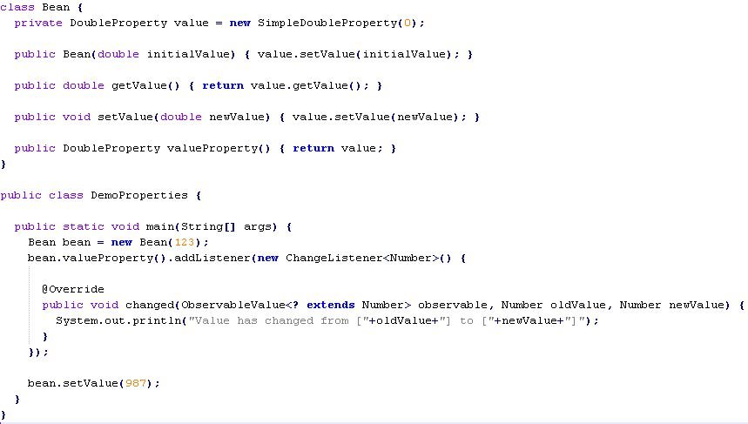
Main features: Properties and Binding (1/3)
Properties are object (or primitive) wrapper to manage listeners on this
3 juillet 2012

Slide 8
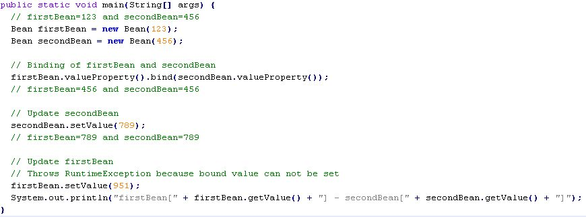
Main features: Properties and Binding (2/3)
Binding is used to link unidirectionaly or bidirectionaly values (or functions of values) of two properties
3 juillet 2012

Slide 9
Main features: Properties and Binding (3/3)
ObservableList and ObservableMap are properties based on collections.
FXCollections is an utility class to create Observable collections (like Lists or Maps in Guava)
Observable collections are used in controls showing many items.
3 juillet 2012

Slide 10
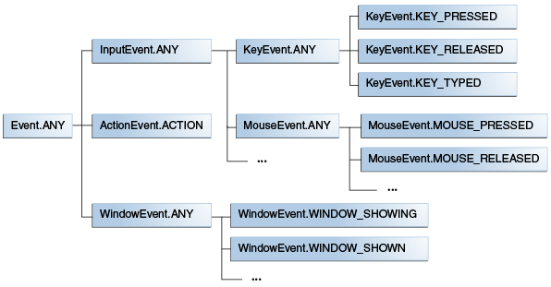
Main features: Events
Events are managed by sub classes of EventHandler<Event>
EventHandler are :
  Designed to listen one type of event (sub class of event)
  Have only one method to implement : « handle(Event) »
  Closure ready
  Could be filtered by EventFilter
3 juillet 2012

Slide 11
Main features: TableView
TableView is JTable substitue. It includes by default, multi column sorting and scroll panes.
TableView is populated with java bean (containing JavaFX properties).
TableView is also containing TableColumn, in charge to convert a field in a row into a visuable component.
3 juillet 2012

Slide 12
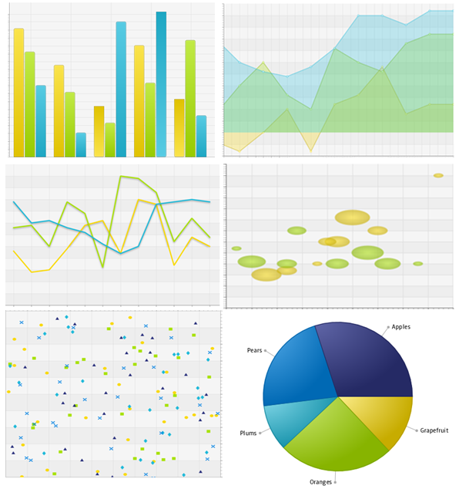
Main features: Charts
Six chart types availlable:
  Pie
  Line
  Area
  Bubble
  Scatter
  Bar
No user actions. They have to be developped (zoom, scrolling, etc)
Bad performances for real time charting…
3 juillet 2012

Slide 13
Main features: Layouts
Integrated into panel so easy to use (by convenient methods)
Same main layouts than Swing
    BorderPane (eq. JPanel with BorderLayout)
    GridPane (eq. JPanel with GridLayout)
    HBox and VBox (eq JPanel with BoxLayout)
    FlowPane (eq JPanel with FlowLayout)
    …
No more GridBagLayout but replaced by AnchorPane (a simplest version)
3 juillet 2012

Slide 14
Main features: FXML and SceneBuilder
FXML is an XML-based language to describe user interface
It is linked with Java source by annotation (@FXML) and direct method call (#myMethod) on controller
SceneBuilder is a WYSIWYG tool to create FXML by drag and dropping JavaFX component
3 juillet 2012

Slide 15
Main features: Look and feel and CSS
Swing defines L&F in java class:
    Need to deploy jar with L&F custom classes
    Need to hard-code to set L&F
    Hard to write custom L&F (Sun recommandations was to avoid it…)
JavaFX uses CSS:
    Based on CSS 2.1, with few CSS 3 features and some improvements for JavaFX
    Everybody who knows CSS could customize L&F
    Everybody could update CSS by editing these files
3 juillet 2012

Slide 16
Main features: Animations
Animations could be use with Transition and TimeLine classes
  Control methods : play, playFromStart, stop, jumpTo
  Parameters : cycle count, auto reverse, delay, rate
Transition is a small « framework » for animations
    Easy to inherit for custom animation (implement « interpolate(double) » method)
    SequencialTransition and ParallelTransition for complex scenarios
    Default transitions (Fade, Fill, Path, Rotate, Scale, Translate, ...)
TimeLine update properties along time progression
    TimeLine works by « properties state snapshot »
    TimeLine executes KeyFrames one by one
    Each KeyFrame is a duration and a list of KeyValue
    Each KeyValue is a property and its final value
3 juillet 2012

Slide 17
3
JavaFX exemples
3 juillet 2012

Slide 18
4
Other features
3 juillet 2012

Slide 19
Other features
Swing interoperability
    Swing can contains FX components (JFXPanel) but not inverse
    Need to deal events and updates between JavaFX and Swing threads
Packaging
    Ant tasks availlable in SDK
    Native packaging (with JRE, JavaFX, jars, datas, …) in JavaFX 2.2
GUI automated tests: JemmyFX
    Plugin to Jemmy application
    JavaFX developpers use it
Development tools
    Plugin Eclipse: e(fx)clipse (efxclipse.org)
    Netbeans
3 juillet 2012

Slide 20
5
What is comming…
3 juillet 2012

Slide 21
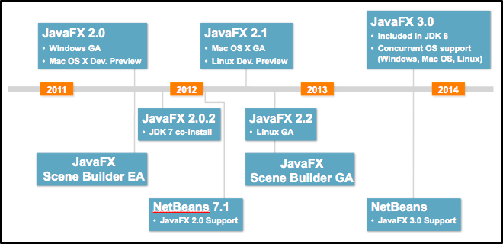
What is comming… (1/2)
3 juillet 2012

Slide 22
What is comming… (2/2)
JavaFX 2.2 (summer 2012)
    SceneBuilder 1.0
    New color picker control
    Enhancements for TableView
JavaFX 3 (summer 2013)
    Include in Java 8
    Use modularity (project Jiqsaw) for packaging
Announced without date…
    Improvements to charts
    Data service support (data persistence, messaging framework)
    Enhancements for WebView (HTML 5)
    Multi-touch, gestures and sensor support (for embedded devices)
    3D Graphics support
3 juillet 2012

Slide 23
6
Questions ?
3 juillet 2012

